Slide 1

Week 2 – Math Foundations & 2D Graphics
CS405: Introduction to Computer Graphics
Sabancı University
Selim Balcısoy

Slide 2
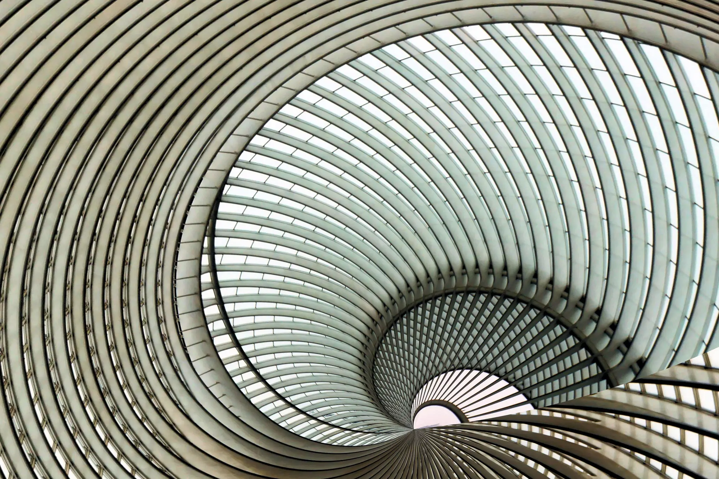

Slide 3
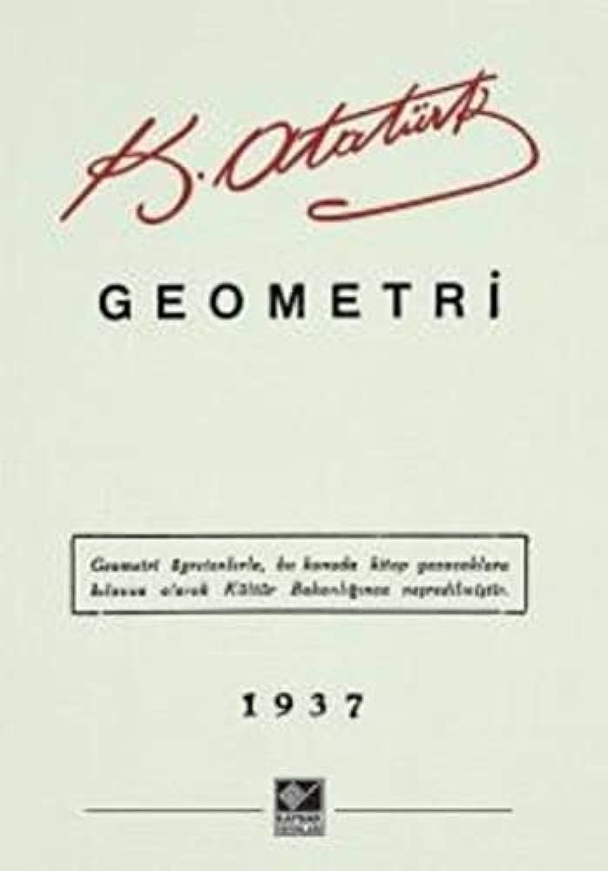

Slide 4
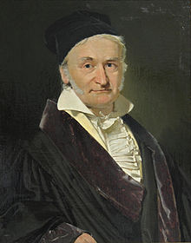
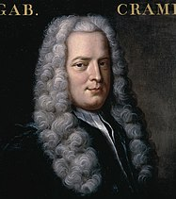
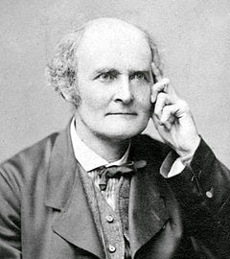
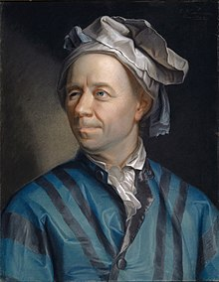
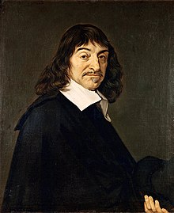
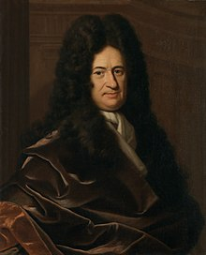
Notes:
Top Row
Left: Carl Friedrich Gauss (1777–1855) A German mathematician and physicist who made significant contributions to many fields, including number theory, algebra, statistics, analysis, differential geometry, geodesy, geophysics, mechanics, electrostatics, astronomy, matrix theory, and optics. He is sometimes referred to as the Princeps mathematicorum (Latin for "the foremost of mathematicians").
Middle: Gabriel Cramer (1704–1752) A Swiss mathematician from Geneva. He is best known for his work on algebra and geometry. His most famous contribution is Cramer's rule, a method for solving systems of linear equations using determinants. The text "GAB. CRAM" above the portrait is an abbreviation of his name.
Right: Arthur Cayley (1821–1895) A British mathematician and one of the founders of the modern British school of pure mathematics. He is best known for developing the algebra of matrices and for his work in group theory, including proving Cayley's theorem.
Bottom Row
Left: Leonhard Euler (1707–1783) A Swiss mathematician, physicist, astronomer, geographer, logician, and engineer who made seminal discoveries in many branches of mathematics, such as infinitesimal calculus and graph theory. He also introduced much of the modern mathematical terminology and notation, including the notion of a mathematical function, f(x), and the symbol for the base of the natural logarithm, e.
Middle: René Descartes (1596–1650) A French philosopher, mathematician, and scientist. Dubbed the "Father of Modern Philosophy," he is also famous for creating the Cartesian coordinate system, which allows for the representation of geometric shapes in a numerical or algebraic form, thus founding analytic geometry.
Right: Gottfried Wilhelm Leibniz (1646–1716) A German polymath active as a mathematician, philosopher, scientist, and diplomat. He is a prominent figure in both the history of philosophy and the history of mathematics. He developed the infinitesimal calculus independently of Isaac Newton and his notation (like dxdy​ for derivatives) has been widely used ever since.

Slide 5

Course Roadmap
Topics: Vectors, Matrices, Transformations, 2D Graphics
Notes:
Welcome to Week 2! This session builds on Week 1 by diving into the mathematical tools essential for graphics. We'll explore how these concepts apply to real-world art, like analyzing perspectives in historical paintings. By the end, you'll see how math turns abstract ideas into visual realities. This roadmap outlines our progression: Start with vectors for basic directions, move to matrices for transformations, and apply them to 2D graphics. These foundations will prepare you for Project 1, where you'll reconstruct geometry from paintings like "Kabataş Rıhtımı."

Slide 6
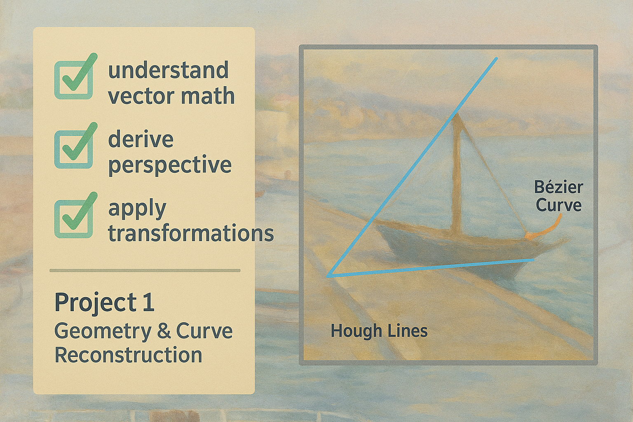
Why Math Matters
Math is the backbone of computer graphics
From equations → images
Without math, graphics would lack precision—think distorted images or unrealistic animations.
In CG, equations define everything from pixel colors to 3D models, enabling tools like WebGL to render scenes efficiently.
Notes:
Motivate importance of math in CG.

Slide 7
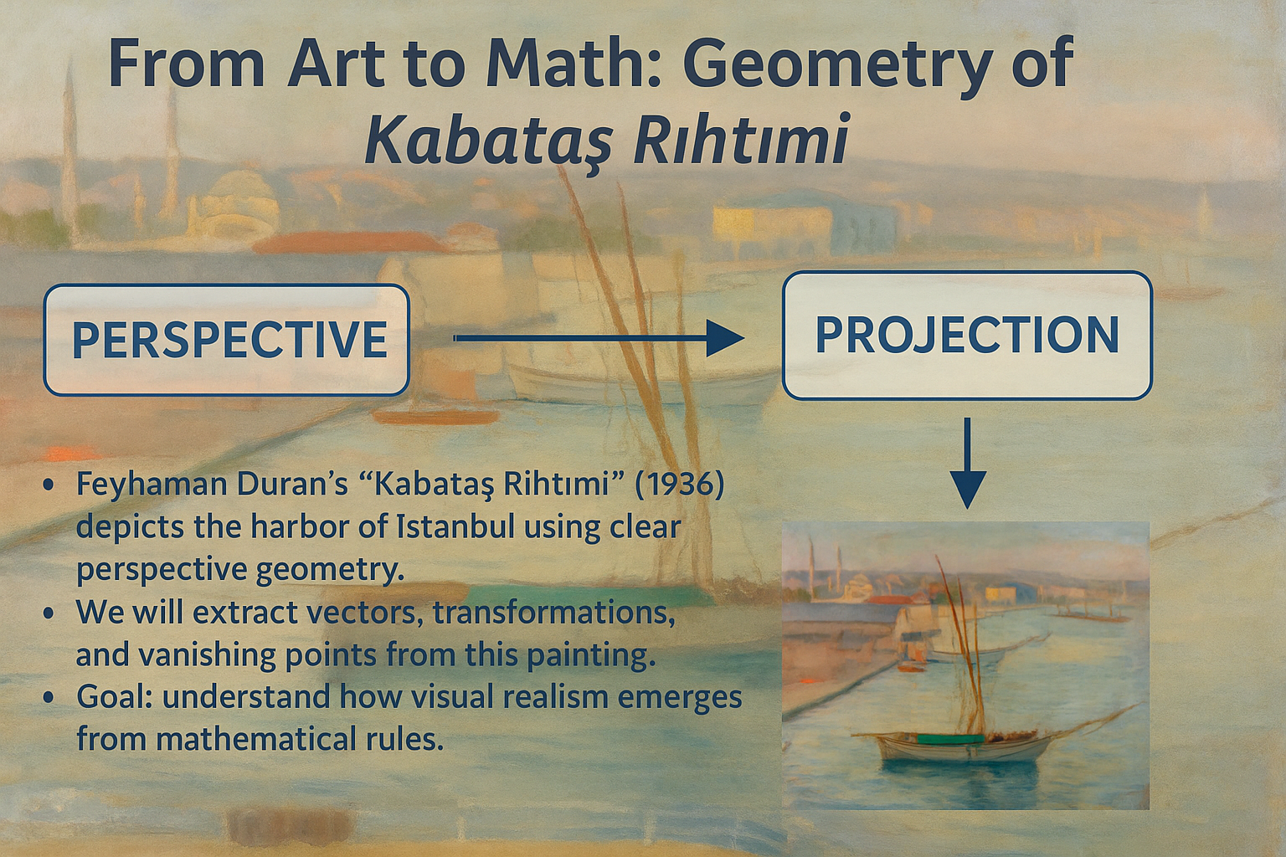
Notes:
Use painting as anchor throughout.

Slide 8

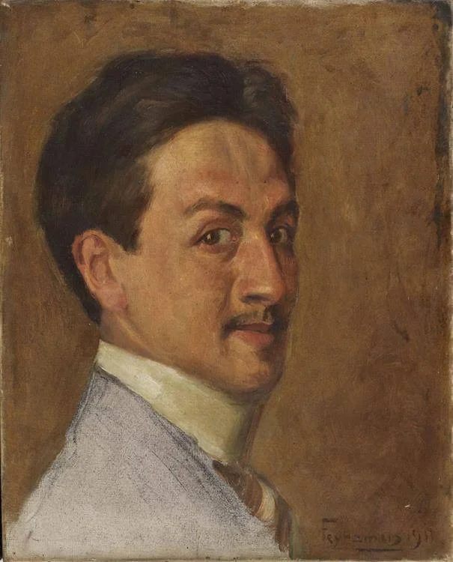
Feyhaman Duran
Feyhaman Duran is considered the first and most important representative of portrait art in Turkish Painting Art. He is one of the painters of the 1914 Çallı Generation. He is especially famous for his portraits of Atatürk and İnönü.
He was born in Istanbul in 1886. He lost his mother at a young age. His father fulfilled his wife’s will and enrolled his son in Galata Palace Humayun School, now known as Galatasaray High School, in 1895. Here, he became a student of painters Şevket Dağ, Tevfik Fikret and Viçen Arslanyan Efendi.

Slide 9
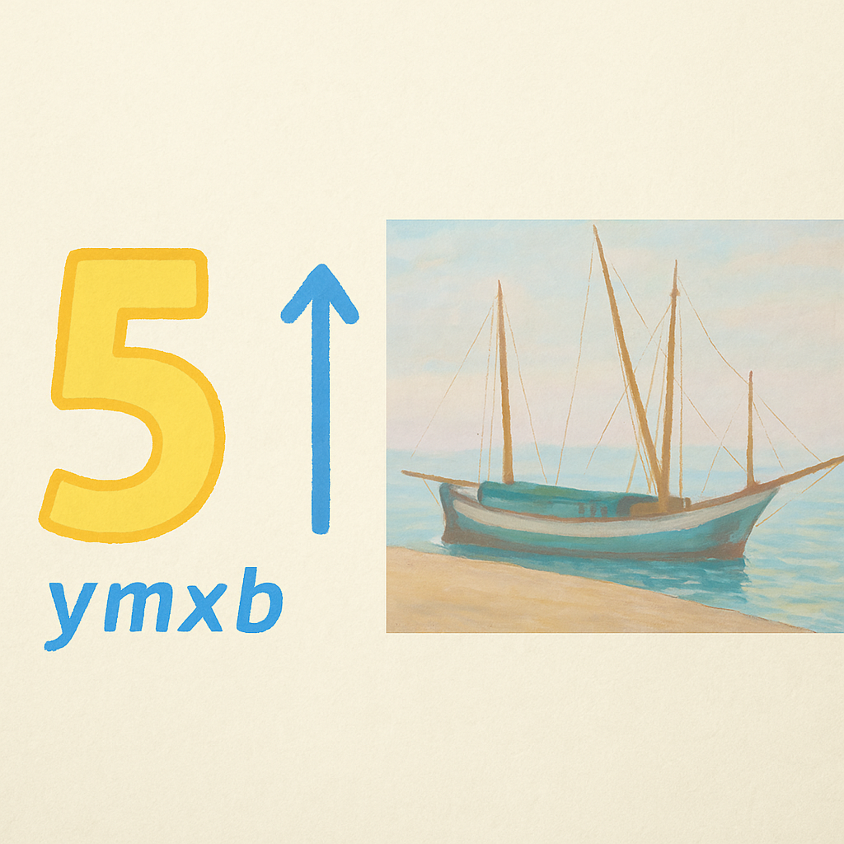
Scalars
Definition: single number
Magnitude only Scalars alone have no geometric properties
Scalars are foundational—e.g., a boat's speed (5 knots) or color intensity (0.8).
They're used in operations like scaling vectors, which we'll see soon.
Notes:
Introduce scalars for later vector definitions.

Slide 10
Points vs Vectors
Point = location
Vector = direction + magnitude
Points fix positions (e.g., a dock coordinate), while vectors describe changes (e.g., boat movement).
In graphics, points define shapes; vectors handle transformations.
Notes:
Distinguish key ideas.

Slide 11
Vector Operations
Every vector has an inverse
Same magnitude but points in opposite direction
Every vector can be multiplied by a scalar
There is a zero vector
Zero magnitude, undefined orientation
The sum of any two vectors is a vector
Use head-to-tail axiom
v
w
v
-v
αv
u

Slide 12
Linear Vector Spaces
Mathematical system for manipulating vectors
Operations
Scalar-vector multiplication u=αv
Vector-vector addition: w=u+v
Expressions such as
v=u+2w-3r
Make sense in a vector space

Slide 13
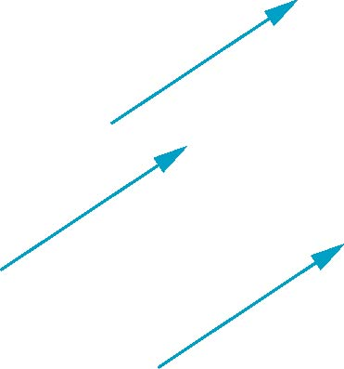
Vectors Lack Position
These vectors are identical
Same length and magnitude
Vectors spaces insufficient for geometry
Need points

Slide 14
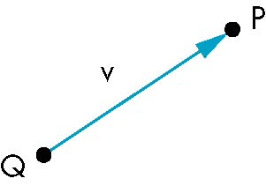
Points
Location in space
Operations allowed between points and vectors
Point-point subtraction yields a vector
Equivalent to point-vector addition
v=P-QS
P=v+Q

Slide 15
The difference of two points (x,y,z,1) and (u,v,w,1) is (x-u, y-v, z-w, 0), which is a vector
The sum of a point (x, y, z, 1) and a vector (d, e, f, 0) is (x + d, y + e, z + f, 1), another point

Slide 16
Coordinate Systems
World, View, Screen
World coords are scene-independent;
View coords are camera-relative;
Screen coords are pixel-based.
This pipeline ensures flexible rendering across devices.
Notes:
Explain why multiple systems exist.

Slide 17
Coordinate Systems
Consider a basis v₁, v₂,…., v_{n}
A vector is written v=a₁v₁+ a₂v₂ +….+a_{n}v_{n}
The list of scalars {a₁, a₂, …. a_{n}}is the representation of v with respect to the given basis
We can write the representation as a row or column array of scalars
a=[a₁ a₂ …. a_{n}]^{T}=

Slide 18
Coordinate Systems
Which is correct?
v
v
Both are because vectors have no fixed location

Slide 19

Homogeneous coordinates
The general form of four dimensional homogeneous coordinates is
p=[x y x w] ^{T}
We return to a three dimensional point (for w≠0) by
x←x/w
y←y/w
z←z/w
If w=0, the representation is that of a vector
Note that homogeneous coordinates replaces points in three dimensions by lines through the origin in four dimensions

Slide 20
Homogeneous coordinates
Homogeneous coordinates are key to all computer graphics systems
OpenGL uses 4D homogeneous coordinates for all its vertices.
If you send it a triple of the form (x,y,z), it converts it
immediately to (x,y,z,1).
If you send it a 2D point (x,y), it first appends a 0 for the z
component and then a 1, to form (x,y,0,1).

Slide 21
Frames
Coordinate System is insufficient to present points
If we work in an affine space we can add a single point, the origin, to the basis vectors to form a frame
v₂
v₁
P₀
v₃

Slide 22
Frame determined by (P₀, v₁, v₂, v₃)
Within this frame, every vector can be written as
v=α₁v₁+ α₂v₂ +….+α_{n}v_{n}
Every point can be written as
P = P₀ + β₁v₁+ β₂v₂ +….+β_{n}v_{n}

Slide 23
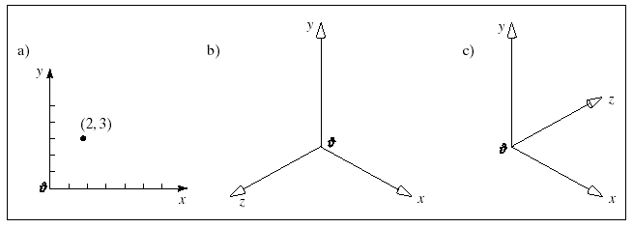
thumb
thumb
Right-handed 3D coordinate system
left-handed 3D coordinate system

Slide 24
Affine Spaces
Point + a vector space
Operations
Vector-vector addition
Scalar-vector multiplication
Point-vector addition
Scalar-scalar operations
For any point define
1 • P = P
0 • P = 0 (zero vector)

Slide 25
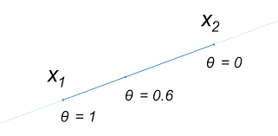
Affine Sums
P( α) = αR + (1-α)Q
This operation looks like the addition of two points and leads to the
equivalent form
P = α₁R + α₂Q, where
α₁+ α₂ = 1

Slide 26
Affine Sums
Consider the “sum”
P=α₁P₁+α₂P₂+…..+α_{n}P_{n}
Can show by induction that this sum makes sense if
α₁+α₂+…..α_{n}=1
in which case we have the affine sum of the points P₁,P₂,…..P_{n}
If, in addition, α_{i}>=0, we have the convex hull of P₁,P₂,…..P_{n}

Slide 27
Affine combination of points
Consider forming a linear combination of two points, P = (P₁, P₂, P₃, 1)
and R = (R₁, R₂, R₃, 1), using the scalars f and g:
fP + gR = (fP₁ + gR₁, fP₂ + gR₂, fP₃ + gR₃, f + g)
This is a valid vector if f + g = 0
It is not a valid point, unless f + g = 1
The only linear combination of points that is valid is an affine
combination.

Slide 28
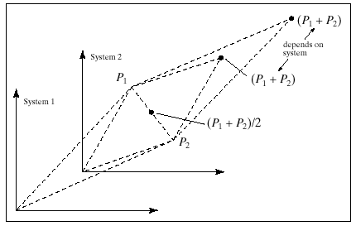
P₁ + P₂ depends on the choice of coordinate system.
The affine combination 0.5 (P₁ + P₂) does not depend on this choice.

Slide 29
A point plus a vector is an affine combination of points
P = A + t (B - A)
P = t B + (1 – t) A !!!!!!!!!Why?

Slide 30
Convexity
An object is convex if for any two points in the object all points on the line segment between these points are also in the object
P
P
Q
Q

Slide 31
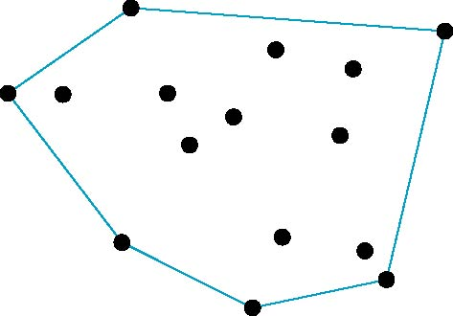
Convex Hull
Smallest convex object containing P₁,P₂,…..P_{n}
Formed by “shrink wrapping” points

Slide 32
Linear combination of vectors 3a + b – 4c
Affine combination of vectors 3a + 2b – 4c
Convex combination of vectors .3a + .7b

Slide 33
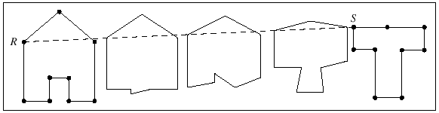
Tweening
P = (1 – t) A_{i} + t B_{i}
This polyline begins with the shape of A and ends with the shape of B,
but in between it is a blend of the two shapes.

Slide 34
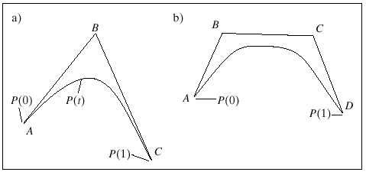
Quadratic and Cubic Tweening
1 = ((1-t) + t) ²
P = (1 – t)² A + 2t (1 – t) B + t² C
This is the Bezier curve for the points A, B, and C.
1 = ((1-t) + t) ³

Slide 35
Linear Interpolation of Two Points
The affine combination of points
P = A (1 – t) + B t
performs a linear interpolation between the points A and B.
lerp(a,b,t) provides a number that is the fraction t of the way from
a to b.
a+ (b-a)*t;
tween (A,B,t) computes the point P(t) that is the fraction t of the way
Along the straight line from point A to point B.

Slide 36
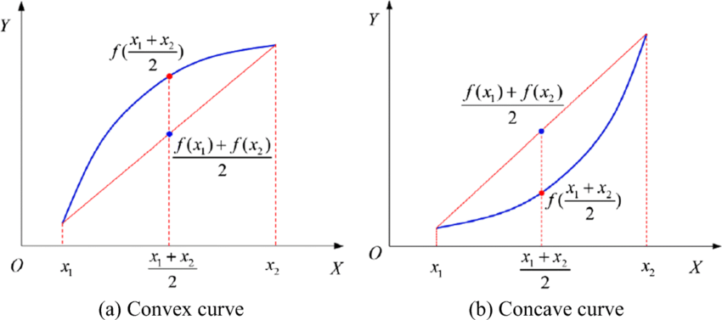
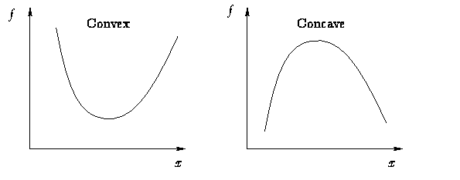
The notion of convexity is extremely important in the design of curves and surfaces.

Slide 37
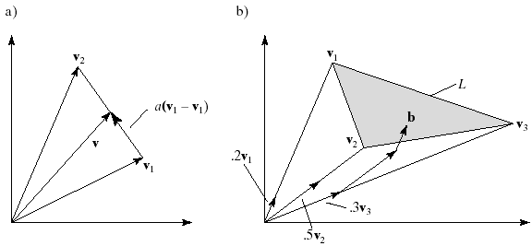
The set of all convex combinations of the two vectors v₁ and v₂
v = (1-α)v₁ + αv₂
v = v₁ + α(v₂ - v₁)

Slide 38
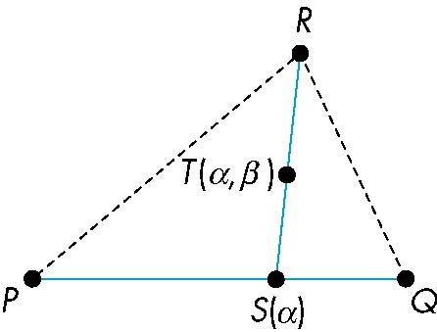
Triangles
Note that all the points Τ(α,β) line in the triangle formed by P, Q, and R.
convex sum of S(α) and R
convex sum of P and Q
for 0<=α,β<=1, we get all points in triangle

Slide 39
Math Tools Recap
Linear algebra
Trigonometry
Geometry
Brush up on dot products (linear algebra), sine/cosine (trig for rotations), and shapes (geometry for meshes).
These are crucial for Project 1's curve fitting.
Notes:
Recall prerequisites for students with weak background.

Slide 40
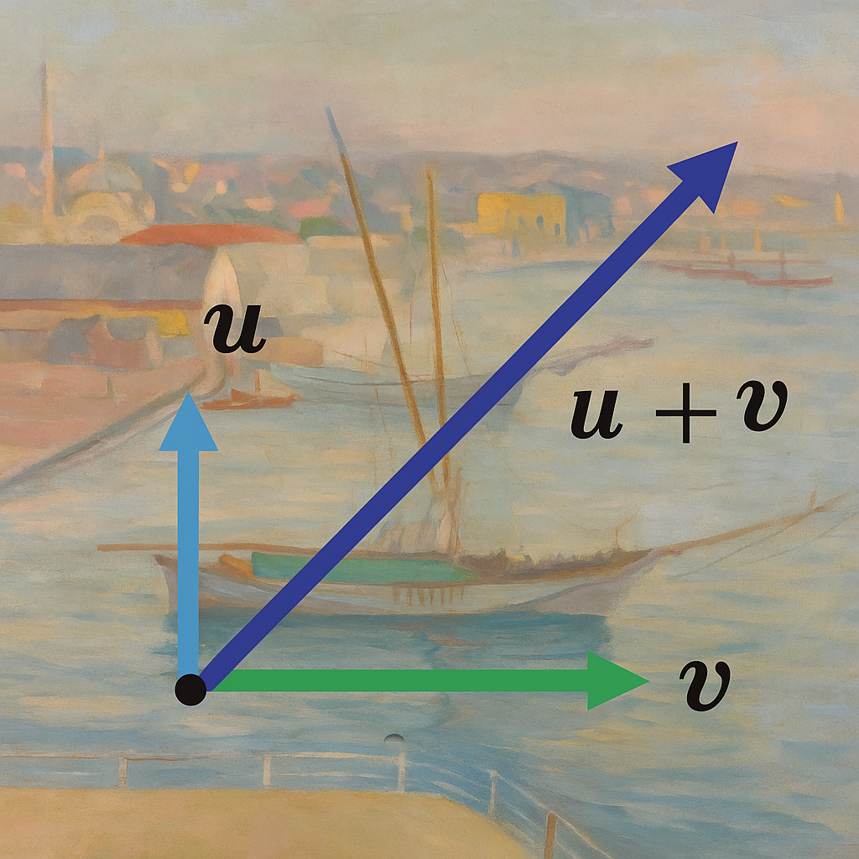
Vector Definition
Arrow with magnitude + direction
Vectors are essential for motion, forces, and directions in CG—e.g., light rays or object velocities.
Notes:
Formal definition.

Slide 41
Vector Length
|a| = sqrt(x²+y²)
Also called magnitude or norm; used for distances, like measuring pier length in pixels.
Notes:
Length of vector.

Slide 42
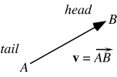
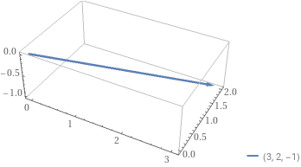
Vector Basics: Length of a Vector
Our Vector is (3,2,-1)
Length of a vector is
||v||=sqrt(x*x+y*y+z*z)
length(v)= sqrt(9+4+1)
length(v)=sqrt(14)=3.74166
Normalized Vector
(3/3.74166, 2/3.74166, -1/3.74166)

Slide 43
Vector Length Example
Compute |(3,4)| = 5
Step: sqrt(9 + 16) = sqrt(25) = 5.
This is the Pythagorean theorem in action.
Notes:
Work numeric example.

Slide 44
Confusing Points and Vectors
Consider the point and the vector
P = P₀ + β₁v₁+ β₂v₂ +….+β_{n}v_{n}
v=α₁v₁+ α₂v₂ +….+α_{n}v_{n}
They appear to have the similar representations
p=[β₁ β₂ β₃] v=[α₁ α₂ α₃]
which confuse the point with the vector
A vector has no position
v
p
v
can place anywhere
fixed

Slide 45
A Single Representation
If we define 0 • P = 0 and 1 • P = P then we can write
v=α₁v₁+ α₂v₂ +α₃v₃ = [α₁ α₂ α₃ 0 ] [v₁ v₂ v₃ P₀] ^{T}
P = P₀ + β₁v₁+ β₂v₂ +β₃v₃= [β₁ β₂ β₃ 1 ] [v₁ v₂ v₃ P₀] ^{T}
Thus we obtain the four-dimensional homogeneous coordinate representation
v = [α₁ α₂ α₃ 0 ] ^{T}
p = [β₁ β₂ β₃ 1 ] ^{T}

Slide 46
Normalization
a/|a| = unit vector
Unit vectors have length 1; useful for directions without scale, like normalizing light vectors.
Notes:
Normalize example.

Slide 47
Addition
a+b = (a1+b1, a2+b2)
Tip-to-tail method; combines displacements, e.g., adding wind and current vectors for boat movement.
Notes:
Vector addition.

Slide 48
Addition Example
(2,1)+(1,3)=(3,4)
Visualize: Start at (2,1), add (1,3) to reach (3,4).
Notes:
Step-by-step numeric.

Slide 49
Subtraction
a-b = (a1-b1, a2-b2)
Finds differences, e.g., relative position between two boats.
Notes:
Vector subtraction.

Slide 50
Subtraction Example
(4,2)-(1,5)=(3,-3)
This could represent direction from one point to another on the pier.
Notes:
Numeric example.

Slide 51
Scalar Multiplication
k·a = (kx,ky)
For k>1, stretches; k<1 compresses; negative reverses direction.
Notes:
Stretch/compress vector.

Slide 52
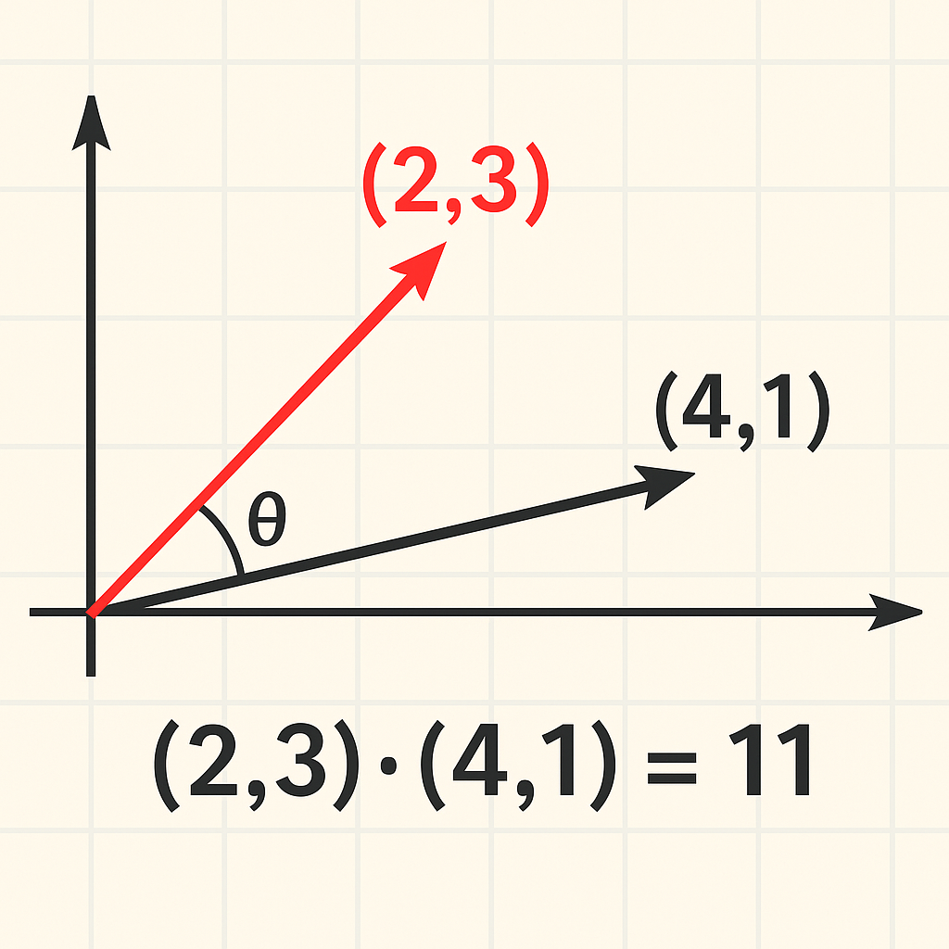
Dot Product Definition
a·b = |a||b|cosθ
Measures similarity; 0 if perpendicular, positive if acute angle.
Notes:
Link to angle.

Slide 53
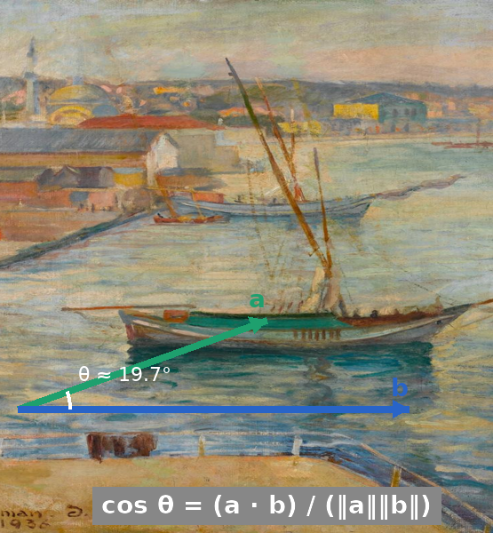
Dot Product Formula
a·b = a1b1+a2b2
Efficient for computation; no need for angles directly.
Notes:
Algebraic form.

Slide 54
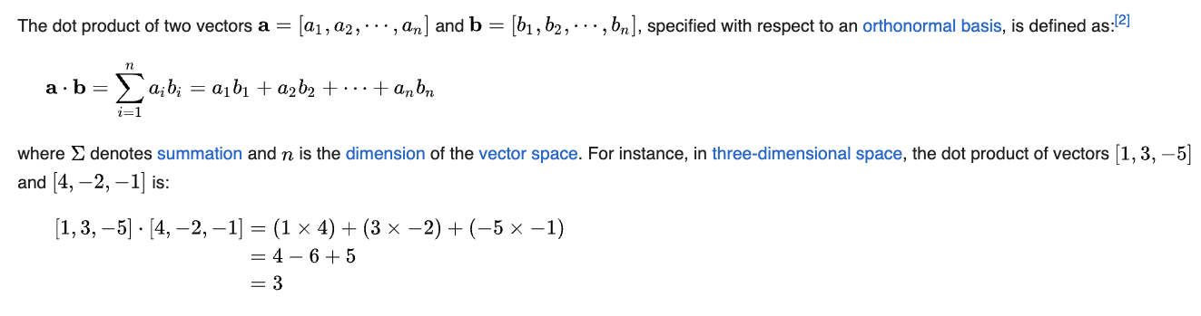
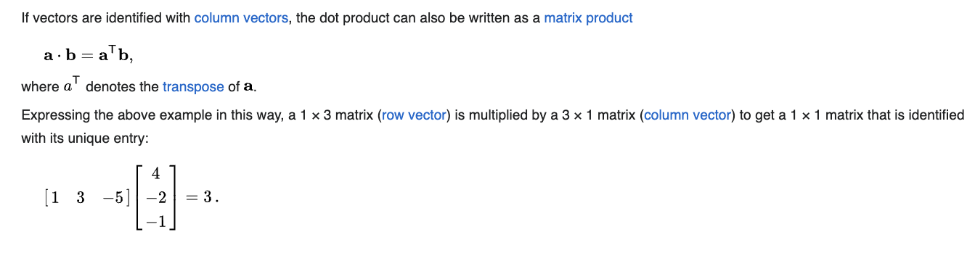
Vector Basics: Dot or Scalar Product

Slide 55
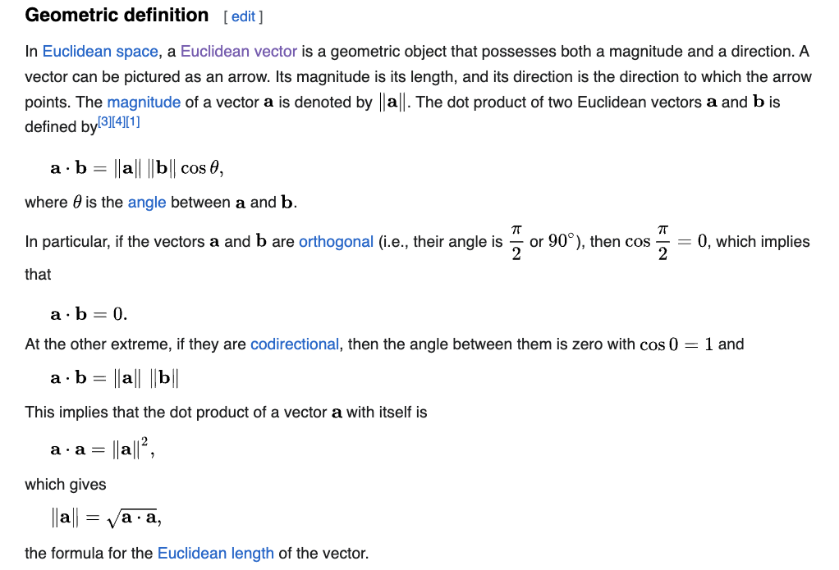
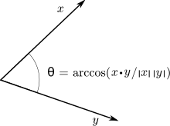
Vector Basics: Dot Product

Slide 56
Dot Product Example
(2,3)·(4,1)=11
24 + 31 = 8 + 3 = 11; interpret as projection scalar.
Notes:
Worked numeric.

Slide 57
Dot Product & Painting
Angle between pier and shoreline vectors
Use dot product to find if lines are orthogonal in the scene.
Notes:
Link to painting geometry.

Slide 58
Projection Formula
proj_a(b)=(a·b/|a|²)a
Projects b onto a; useful for shadows or decompositions.
Notes:
Introduce projection.

Slide 59
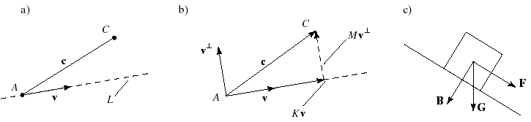
Resolving a vector into two orthogonal vectors

Slide 60
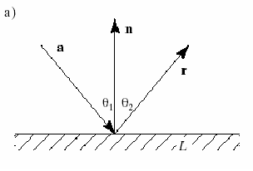
Applications of Projections: Reflections

Slide 61
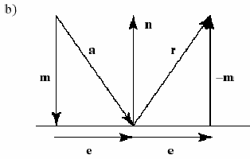

Slide 62
The 2D Perp Vector
Let a = (a_{x},a_{y}). Then a┴ = (-a_{y},a_{x}) is the counterclockwise
perpendicular to a.

Slide 63
Cross Product Preview
In 3D only
Area and perpendicular vector
2D analog is determinant; extends to normals in 3D.
Notes:
Foreshadow Week 3.

Slide 64
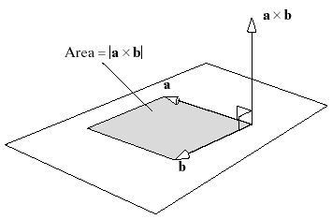
Cross Products

Slide 65
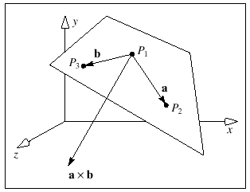
Normals
Every plane has a vector n normal (perpendicular, orthogonal) to it
n = a × b is normal to every line in the plane.

Slide 66
Recap Vectors
Operations, length, projection
Key takeaway: Vectors model directions in graphics scenes.
Notes:
Conclude vector section.

Slide 67


Slide 68
Next: Matrices
Introduce linear transformations
Matrices apply operations to entire sets of vectors efficiently.
Notes:
Transition.

Slide 69
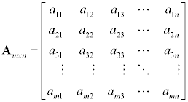
Matrix Revisited
Rectangular array of real numbers
m rows by n columns
Named using capital letters
First subscript is row, second subscript is column
Terminilogy
A matrix with m rows and n columns is called a matrix of order m x n.
A square matrix is a matrix with an equal number of rows and columns. Since the number of rows and columns are the same, it is said to have order n.
The main diagonal of a square matrix are the elements from the upper left to the lower right of the matrix.
A row matrix is a matrix that has only one row.
A column matrix is a matrix that has only one column.
A matrix with only one row or one column is called a vector.

Slide 70
Matrix Definition
Array of numbers
Linear transformations
Rows/columns represent coords; multiply to transform.
Notes:
Basics of matrices.

Slide 71
Matrix Revisited
The system of linear equations ...
x + y - z = 1 3
x - 2y + z = 3
4x + y - 2z = 9
becomes the augmented matrix ...

Slide 72
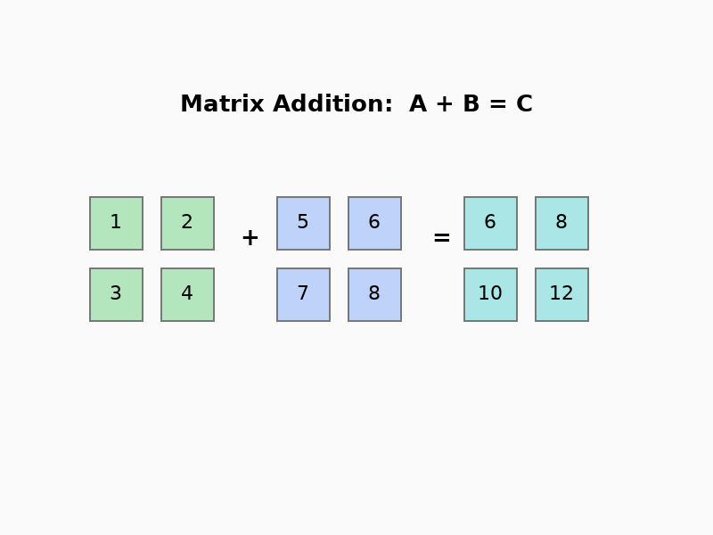
Matrix Addition
Element-wise addition
Like vector addition but for grids; rarely used alone in CG.
Notes:
Simple operation.

Slide 73
Matrix Multiplication
Row·Column rule
Non-commutative; order matters in transformations.
Notes:
Explain multiplication.

Slide 74
Matrix Revisited
A_{m×n} × B_{n×p} = C_{m×p}
The number of columns in the first matrix must be equal to the number of rows in the second matrix. That is, the inner dimensions must be the same.
The order of the product is the number of rows in the first matrix by the number of columns in the second matrix. That is, the dimensions of the product are the outer dimensions.
Since the number of columns in the first matrix is equal to the number of rows in the second matrix, you can pair up entries.
Each element in row i from the first matrix is paired up with an element in column j from the second matrix.
The element in row i, column j, of the product is formed by multiplying these paired elements and summing them.
Each element in the product is the sum of the products of the elements from row i of the first matrix and column j of the second matrix.
There will be n products which are summed for each element in the product.

Slide 75
Multiplication Example
[[1,2],[3,4]]*[ [2],[1] ]
Result: [[4],[10]]; step-by-step calculation.
Notes:
Numeric demo.

Slide 76
Determinant
2x2: ad-bc
Positive for orientation preserve; zero if singular.
Notes:
Scaling factor.

Slide 77
Determinant Example
|[[2,0],[0,3]]|=6
Represents volume scaling in higher dims.
Determinants in 3D computer graphics are used to measure the scale factor of transformations, indicating how much a matrix stretches or shrinks space (e.g., the determinant of a transformation matrix gives the change in volume).
They also determine whether an orientation is preserved or flipped — a negative determinant means the transformation mirrors the geometry.
Additionally, determinants are used to compute matrix inverses, crucial for transforming coordinates between world, view, and screen spaces.
Notes:
Numeric example.

Slide 78
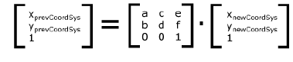
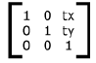
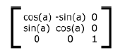
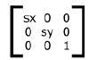
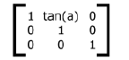
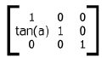
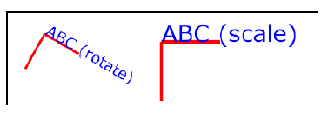
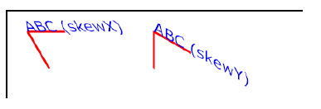
2D Transformations
Translation
Rotation
Scale
Skew
Rotation about the origin

Slide 79
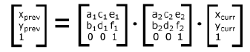
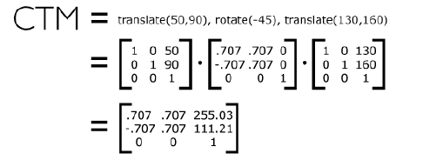

2D Transformations
Nested Transformations
Current Transformation Matrix

Slide 80

Rotation Matrix
R(θ)=[[cosθ,-sinθ],[sinθ,cosθ]]
Counter-clockwise; determinant 1.
Notes:
Introduce rotation.

Slide 81
Rotation Example
Rotate (1,0) by 90° → (0,1)
Matrix: [[0,-1],[1,0]].
Notes:
Numeric demo.

Slide 82
Rotation & Painting
Rotate boat vector to align with pier
Simulates viewpoint change in the scene.
Notes:
Visual link.

Slide 83

Scaling Matrix
S(sx,sy)=[[sx,0],[0,sy]]
Non-uniform if sx ≠ sy.
Notes:
Scaling transformation.

Slide 84
Scaling Example
Scale (2,1) by (2,3) → (4,3)
Applies to zoom in graphics.
Notes:
Numeric demo.

Slide 85
Translation Example
Translate (2,3) by (5,1) → (7,4)
Matrix: [[1,0,5],[0,1,1],[0,0,1]].
Notes:
Numeric demo.

Slide 86
Composition
Apply rotate+translate
Right-to-left application in column vectors.
Notes:
Matrix multiplication order matters.

Slide 87
Inverse Matrix
Undo transformation
A * A⁻¹ = Identity; for reversing views.
Notes:
Inverse importance.

Slide 88
Identity Matrix
Neutral element
[[1,0],[0,1]]; no change.
Notes:
Identity in transformations.

Slide 89
Representing Lines and Planes

Slide 90

Lines

Slide 91

Parametric Representation
Consider all points of the form
P(α)=P₀ + α d
Set of all points that pass through P₀ in the direction of the vector d
for the segment, 0 ≤ α ≤ 1;
for the ray, 0 ≤ α < ∞;
for the line, -∞ < α < ∞;

Slide 92
This form is known as the parametric form of the line
More robust and general than other forms
Extends to curves and surfaces

Slide 93

Rays and Line Segments
If α ≥ 0, then P(α) is the ray leaving P₀ in the direction d
If we use two points to define v, then
P( α) = Q + α (R-Q)=Q+αv
=αR + (1-α)Q
For 0 ≤ α ≤ 1 we get all the
points on the line segment
joining R and Q

Slide 94
Point normal form for the Equation of a Line (Implicit form)
f x + g y = 1 (2D)
(f, g) . (x, y) = 1 (What is this ?)
Every point (x,y) that satisfies this equation lies on the line so the equation provides a condition for a point to be on the line.
(This form is very useful in such tasks as clipping, eliminating hidden
lines, and tracing rays.)

Slide 95

Point normal form (Implicit form)
The line passes through the points C and B. What is the point normal
form of L?
n . (R-C) = 0
For any R(x,y).
A certain dot product must turn out to be zero for every point R on the line.

Slide 96
Example: L passes through C=(3,4) and B=(5,-2)
Find the point normal form of L.
Find the parametric form of L.

Slide 97


Slide 98

Planes
A plane can be determined by a point and two vectors or by three points
P(α,β)=R+αu+βv
P(α,β)=R+α(Q-R)+β(P-Q)

Slide 99
The line segment that joins A and C is the set of points of the form
S (α) = αC + (1-α)A
0 ≤ α ≤ 1
Suppose that we take an arbitrary point on this line segment and form
the line segment from this point to B
T (β) = βS + (1-β)B
0 ≤ β ≤ 1
Such points are determined by both α and β, and form the plane
determined by A,B, and C.
T (α,β) =β[αC + (1-α)A] + (1-β)B
T (α,β) = C + β(1−α)(A – C) + (1-β)(B-C)

Slide 100
T (α,β) = C + β(1−α)(A – C) + (1-β)(B-C)
Noting that A-C and B-C are arbitrary vectors, a plane can be
determined as:
T (s,t) = C + su + tv
We can rearrange terms to obtain the affine combination of points:
T (s,t) = sA + tB + (1-s-t)C
In mathematics, an affine combination of vectors x1, ..., xn is a linear combination in which the sum of the coefficients is 1

Slide 101
Example: Plane passing through A=(3,3,3), B=(5,5,7) and C=(1,2,4)
Find the parametric form of the plane.
Find the point normal form of the plane.

Slide 102

The point normal form for a plane
A plane is completely specified by giving a single point B that lies
within it and the direction n of the normal to the plane.
n . (R – B) = 0

Slide 103
Example: Plane passing through A=(1,2,3) with normal vector
N=(2, -1, -2)
Write the Point Normal Form

Slide 104
Example: Find a parametric form for the plane 2x – y + 3z = 8

Slide 105
Normal n (2,-1,3)
A point on the plane C (4,0,0)
Two vectors on the plane:
Condition n.a=0
a(1,5,1) b(0,3,1)
Parametric form
P(s,t) = (4,0,0) + (1,5,1)s + (0,3,1)t

Slide 106
Given the normal n to a plane, can you find two points on the plane.

Slide 107

Planar patches
To each point (s,t) in parameter space, one 3D
point in the patch corrresponds P(s,t) = C +as + bt.
P(0,0) = C
P(1,0) = C + a
P(0,1) = C + b
P(1,1) = C + a + b

Slide 108
Example: Let C = (1,3,2), a = (1,1,0), b = (1,4,2)
Find the corners of the planar patch.

Slide 109
Example: Find the values of a, b and C that create a square patch of
length 4 on a side, centered at the origin and parallel to the x,z-plane.

Slide 110

Finding the Intersection of two line segments
AB (t) = A + bt b = B - A
CD (u) = C + du d = D - C
A + bt = C + du

Slide 111
Example: Given the endpoints A = (0,6), B = (6,1), C = (1,3), and
D = (5,5), find the intersection of the lines AB and CD if it exists.

Slide 112

The Circle Through 3 points
The center S of the desired circle must be equidistant from all three
vertices, so it must lie on the perpendicular bisector of each side of
triangle ABC.

Slide 113



Intersection of lines with planes; clipping
n . (P – B) = 0
n . (A + ct_{hit} – B) = 0
n . (A – B) + (n . ct_{hit}) = 0

Slide 114

if n . c > 0 the ray is aimed “along with” the normal
if n . c = 0 the ray is parallel to the line
if n . c < 0 the ray is aimed “counter to” the normal

Slide 115

Polygons are fundamental objects that are used in 2D and 3D graphics.
In 3D, an object is often modeled as a polygonal “mesh”; a collection
of polygons.
If the skin forms a closed surface that encloses some space, the mesh
is called a polyhedron.

Slide 116
Polygon Intersection Problems
Is a given point P inside or outside the object?
Where does a given ray R first intersect the object?
Which part of a given line L lies inside the object, and which part
lies outside

Slide 117

Convex Polygons and Polyhedra
Convex polygon is completely described by a set of “bounding lines”
In 3D, a convex polyhedron is completely described by a set of
“bounding planes”

Slide 118

Finding the bounding lines
(-1, 0) . (P – (0,0) = 0
(0, -1) . (P – (0,0) = 0
(1, 1) . (P – (1,0) = 0
Note that in each case the outward normal is used

Slide 119

Ray Intersections and Clipping for convex polygons
Since P is convex, the ray hits P exactly twice.
Entering hit point = A + c t_{in}
Exiting hit point = A + c t_{out}
The ray is inside P for all t in the interval [t_{in}, t_{out}]

Slide 120

The Clipping problem
To find the clipped segment, compute t_{in} and t_{out}
A’ = A + c max(0,t_{in})
C’ = A + c min(1,t_{out})

Slide 121
How are t_{in} and t_{out} computed?
Consider each of the bounding lines of P in turn and find where the
ray A + ct intersects that line.
Assume that each bounding line of P is stored in point normal form as the
pair {B, n}
if n . c > 0 the ray is aimed “along with” the normal
If n . c > 0 the ray is exiting from P
If n . c = 0 the ray is parallel to the line
If n . c < 0 the ray is entering P
if n . c = 0 the ray is parallel to the line
if n . c < 0 the ray is aimed “counter to” the normal

Slide 122

[t_{in} , t_{out} ] is the candidate interval of t, the interval inside of which
the ray might lie inside the object.

Slide 123
Initialize the candidate interval to [0,1]
For each bounding line, find the hit time t_{hit} and determine whether
it is an entering or exiting hit
If entering hit, set t_{in} = max (t_{in}, t_{hit})
If exiting hit, set t_{out} = min (t_{out}, t_{hit})
If the candidate interval is not empty, then, the segment from A + c t_{in} to A + c t_{out} lies inside P. (For clipping, the endpoints of the clipped line, for ray tracing, entering and exiting points of the ray)
Stop if the candidate interval vanishes

Slide 124



Slide 125

The Cyrus-Beck clipping algorithm
(Clipping of a line segment against any convex polygon)

Slide 126

Clipping against arbitrary polygons
Find where the ray A + ct lies inside the polygon P given the list
of vertices P₀, P₁, ..., P_{N-1}

Slide 127
The ray can enter and exit from P multiple times and the result of
clipping a segment against P may result in a list of segments rather
than a single one.
P is no longer described by a collection of infinite bounding lines in
point normal form; we must work with the N finite segments such as
P₃P₄ that form its edges.

Slide 128

Represent each edge of P parametrically.
The ith edge is given by P_{i} + e_{i}u, for u in [0,1] e_{i} = P_{i+1} – P_{i} P_{N} = P₀
The ray A + ct hits the ith edge when t and u have the proper values to
Make A + ct = P_{i} + e_{i}u
ct = b_{i} + e_{i}u
If is zero, the ith edge is parallel to the direction of c and there
is no intersection.

Slide 129

Edge u t
0 0.3846 0.2308
1 -0.727 -0.2727
2 0.9048 0.7142
3 0.4 0.6
4 0.375 0.375

